Slide 1

Employee retention

Slide 2
HR analytics plays a vital role in measuring the return on investment (ROI) of employee retention programs by providing valuable quantitative insights. It delves into various metrics such as turnover rates, engagement scores, training investments, and recruitment expenses.
Key insights of the report is about the attrition happening with the employee records.
Getting valuable insights using
Excel
power bi
Tableau
Mysql

Slide 3
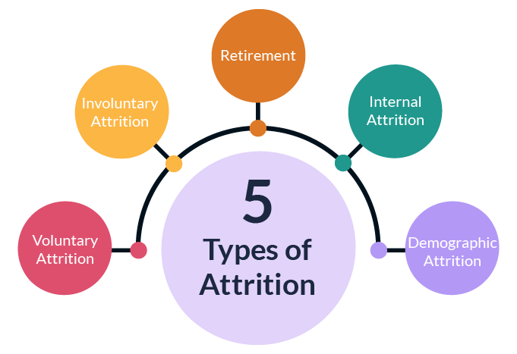
Average Attrition rate for all Departments
Attrition is the departure of employees from the organization for any reason (voluntary or involuntary), including resignation, termination, death or retirement.

Slide 4
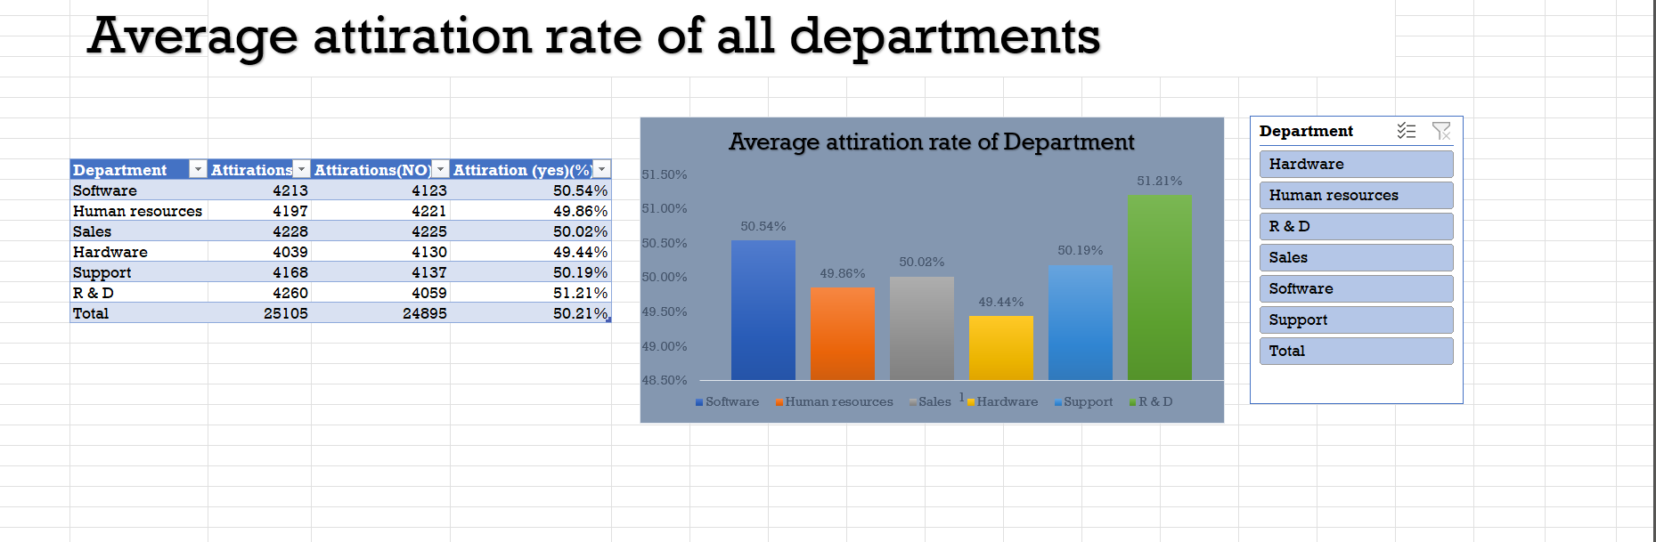
Using excel

Slide 5
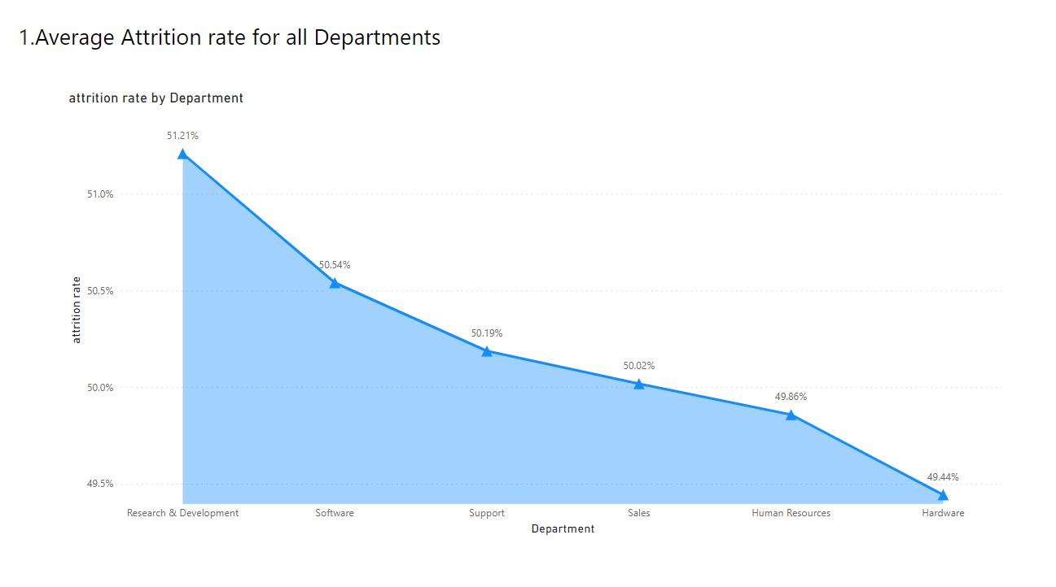
Using power bi

Slide 6
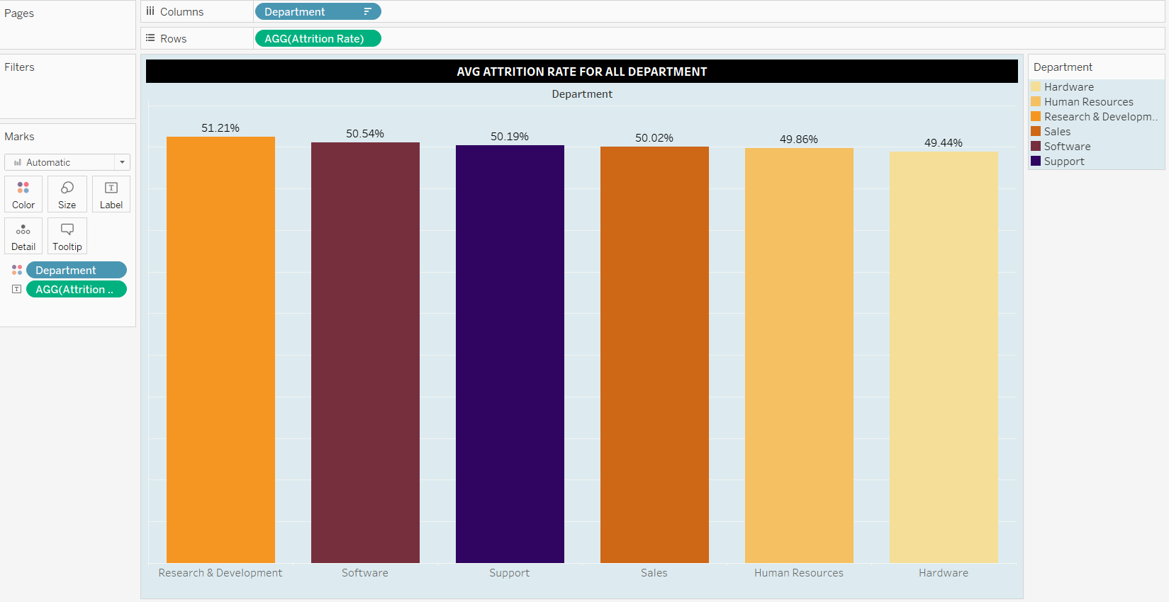
Using tableau

Slide 7
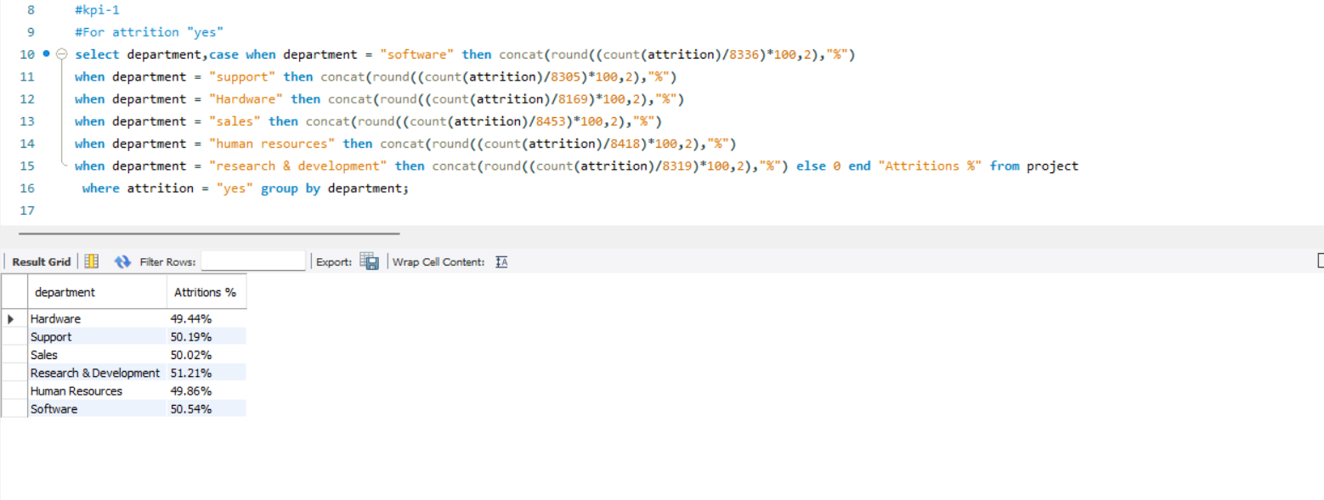
Using Mysql

Slide 8
Key performance indicator-1
Hardware with lowest attrition(49.44%)
Research & Development with highest attrition(51.21%)
There was less change of employees in hardware department and there’s highest change of employees in Research & Development
department

Slide 9

2.Average Hourly rate of Male Research Scientist
The amount of average money paid for a male research scientist.
By this KPI we can get to know how much money is being utilized by the research scientist in the company.

Slide 10
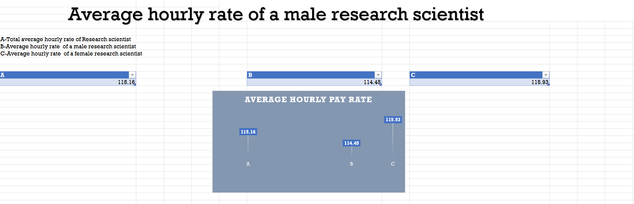
Using excel

Slide 11
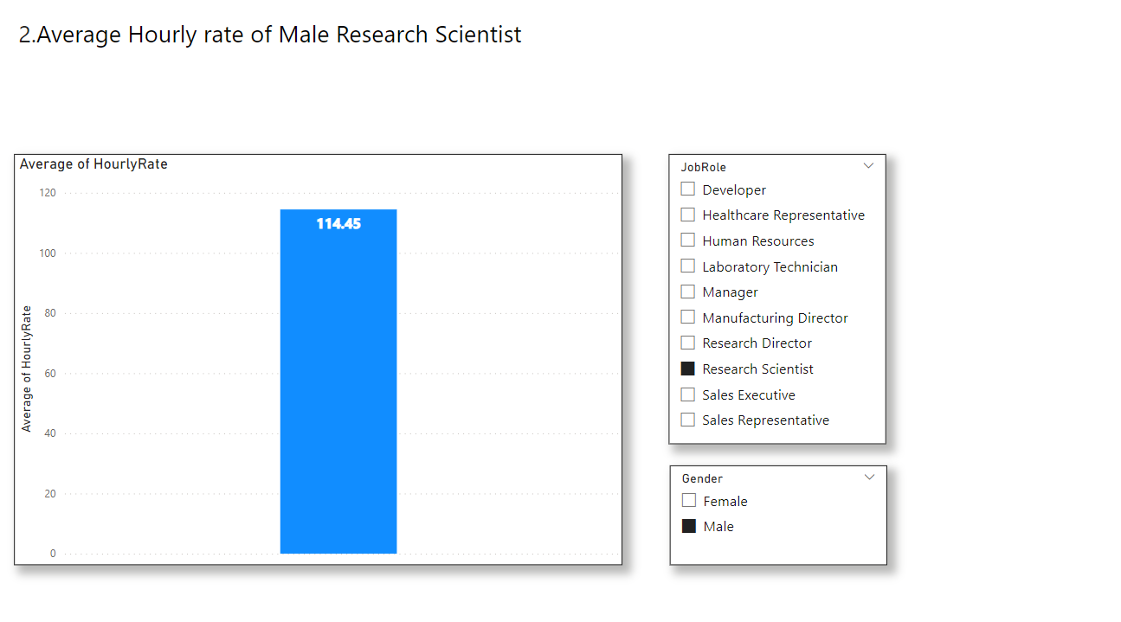
Using power bi

Slide 12
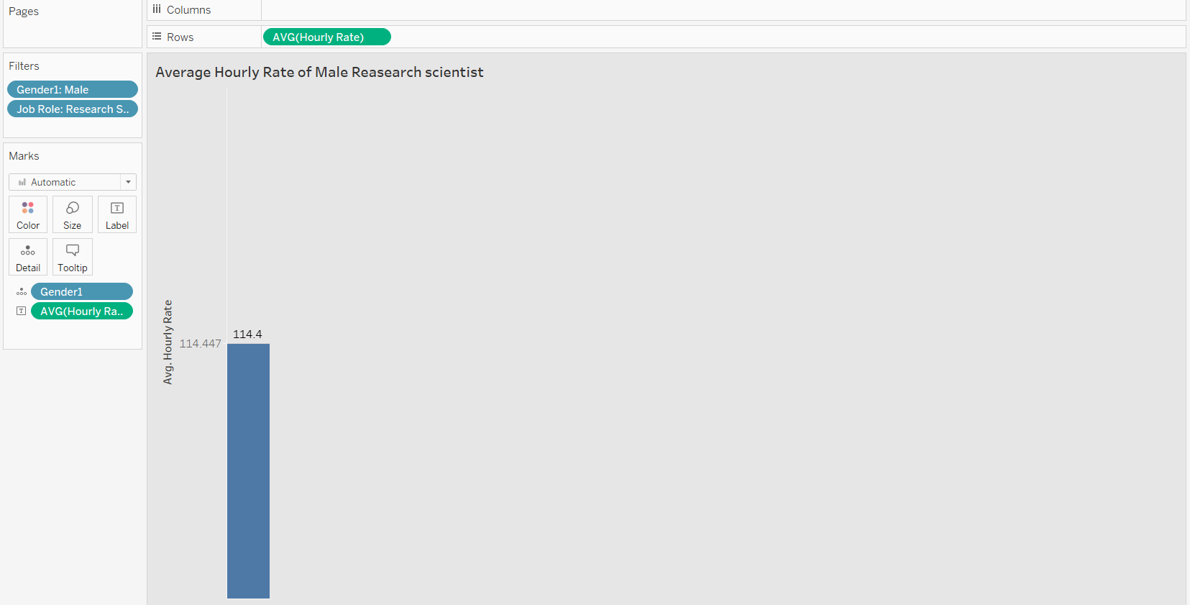
Using tableau

Slide 13
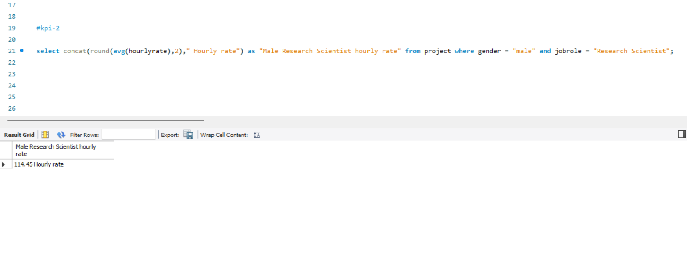
Using Mysql

Slide 14
Key performance indicator-2

Slide 15
3.Attrition rate Vs Monthly income stats

Slide 16
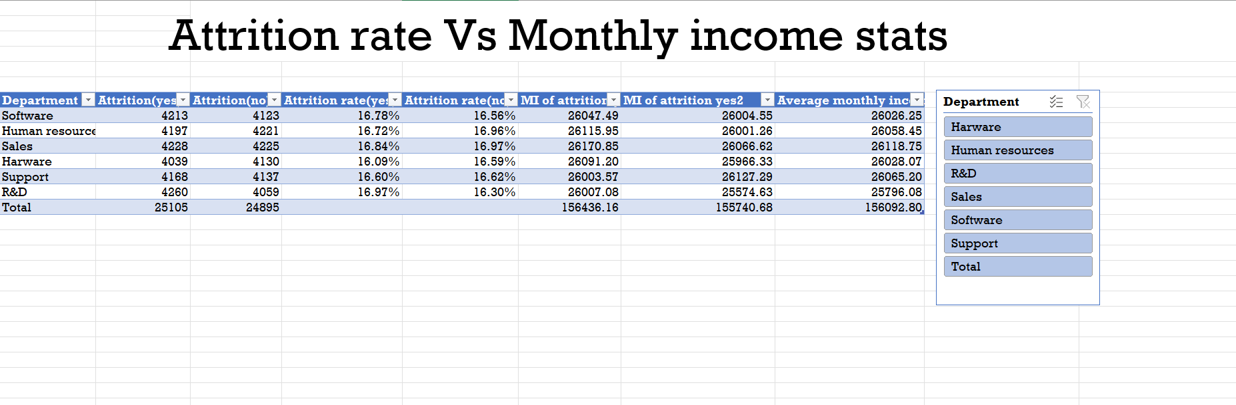
Using excel

Slide 17
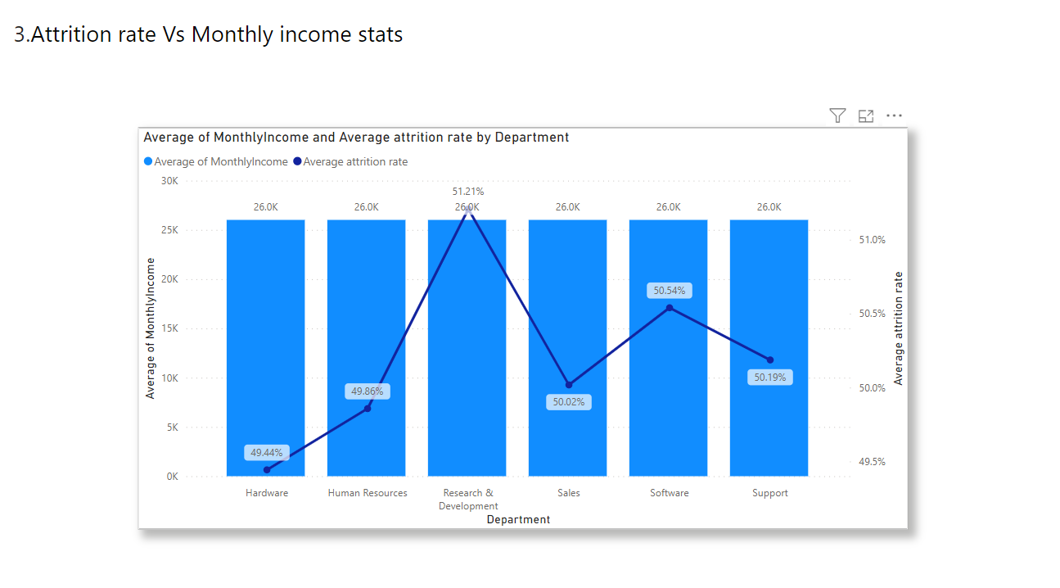
Using power bi

Slide 18
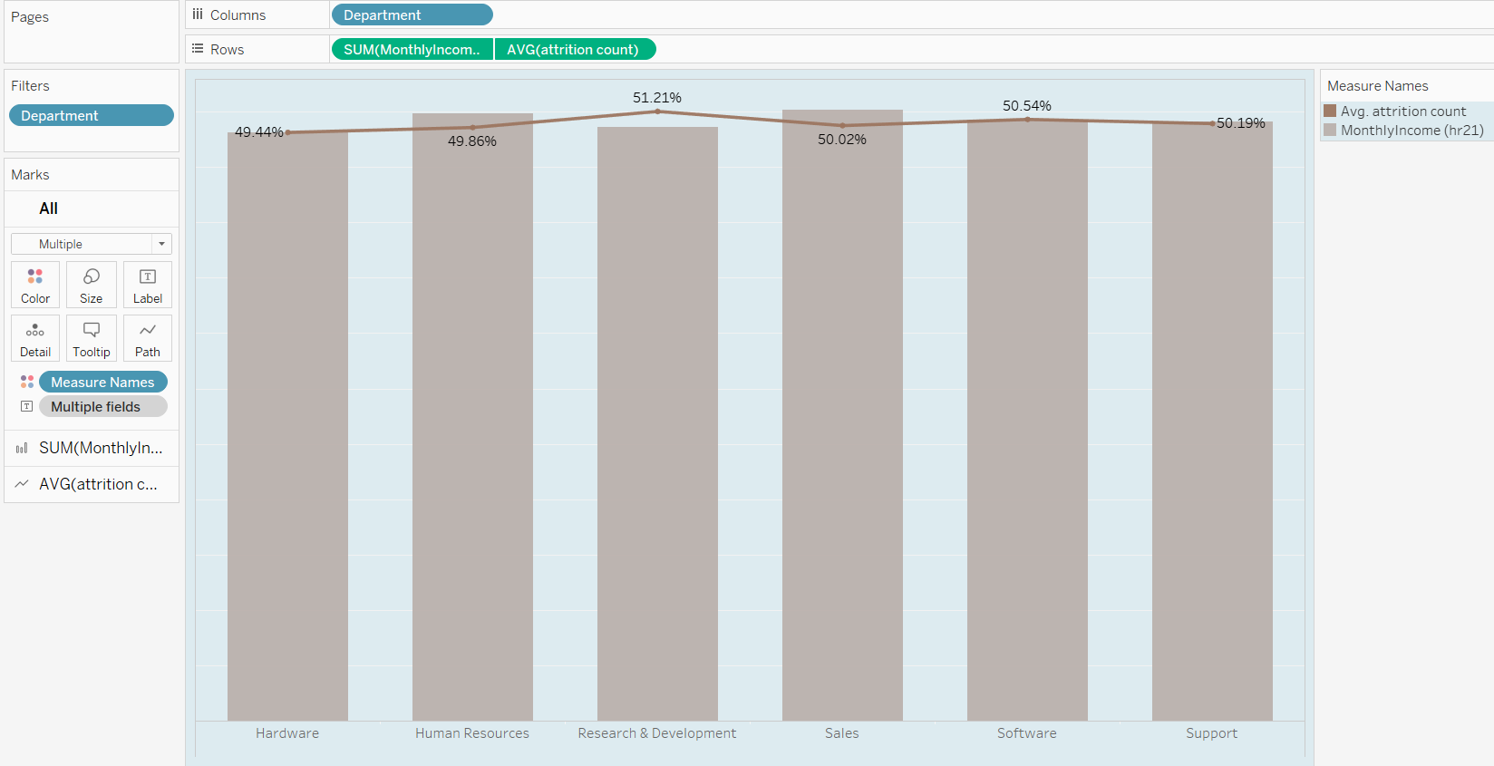
Using tableau

Slide 19
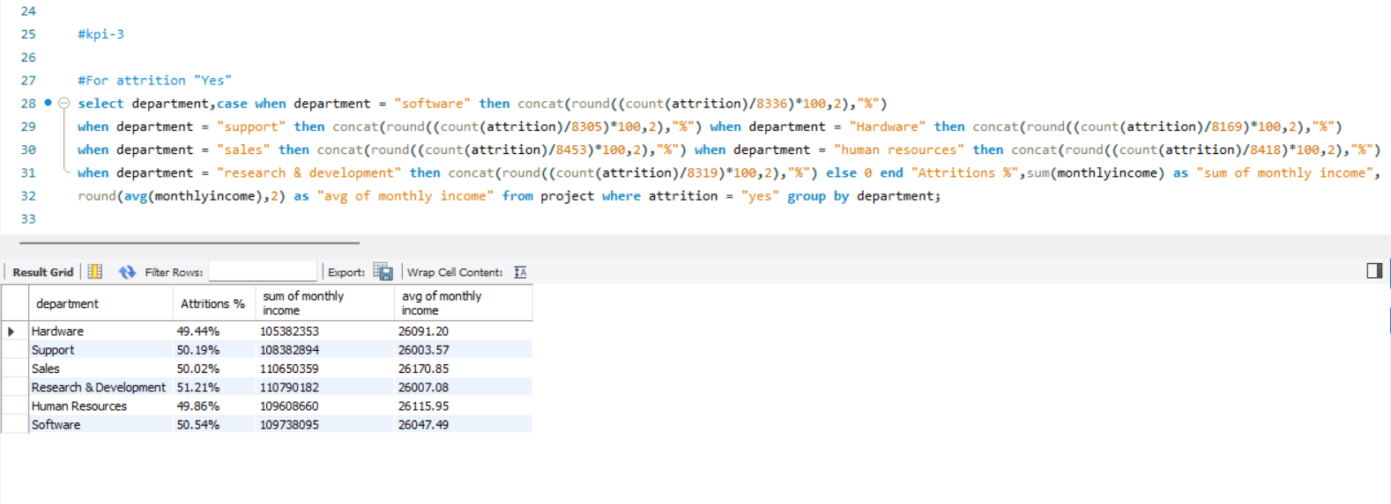
Using Mysql

Slide 20
Key performance indicator-3

Slide 21
4.Average working years for each Department

Slide 22
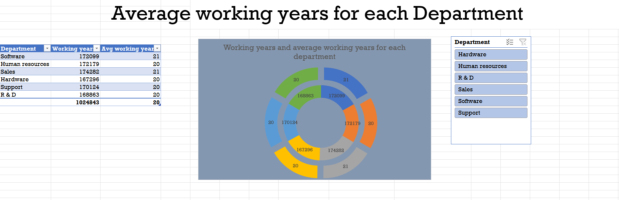
Using excel

Slide 23
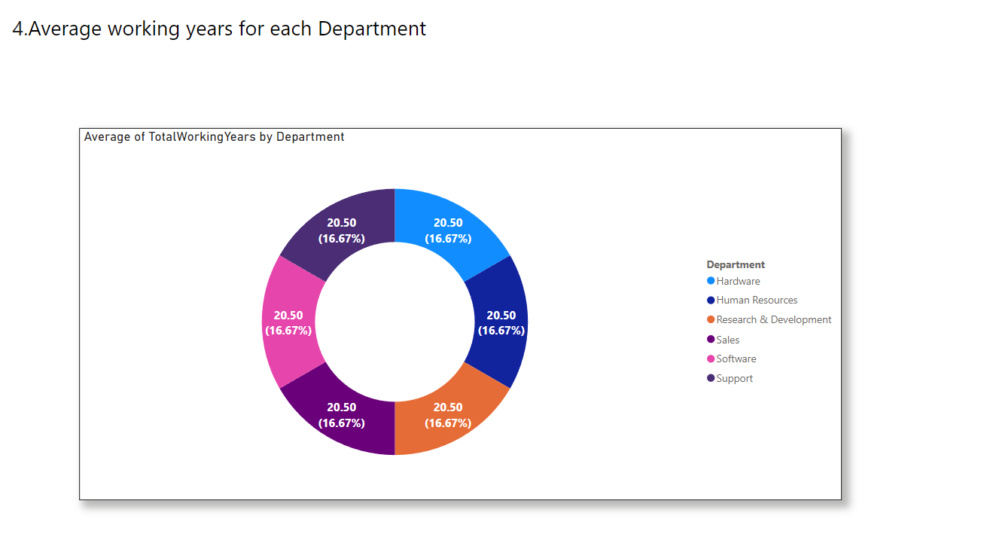
Using power bi

Slide 24
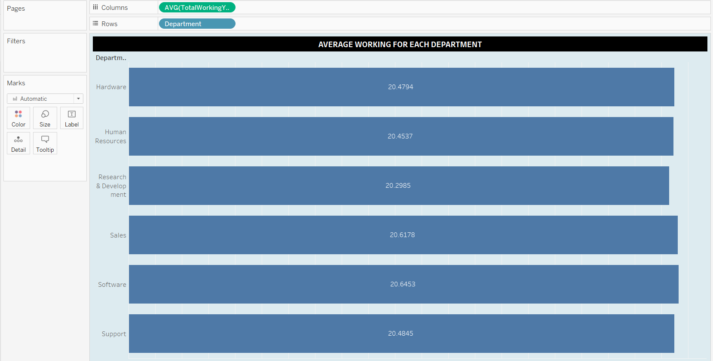
Using tableau

Slide 25
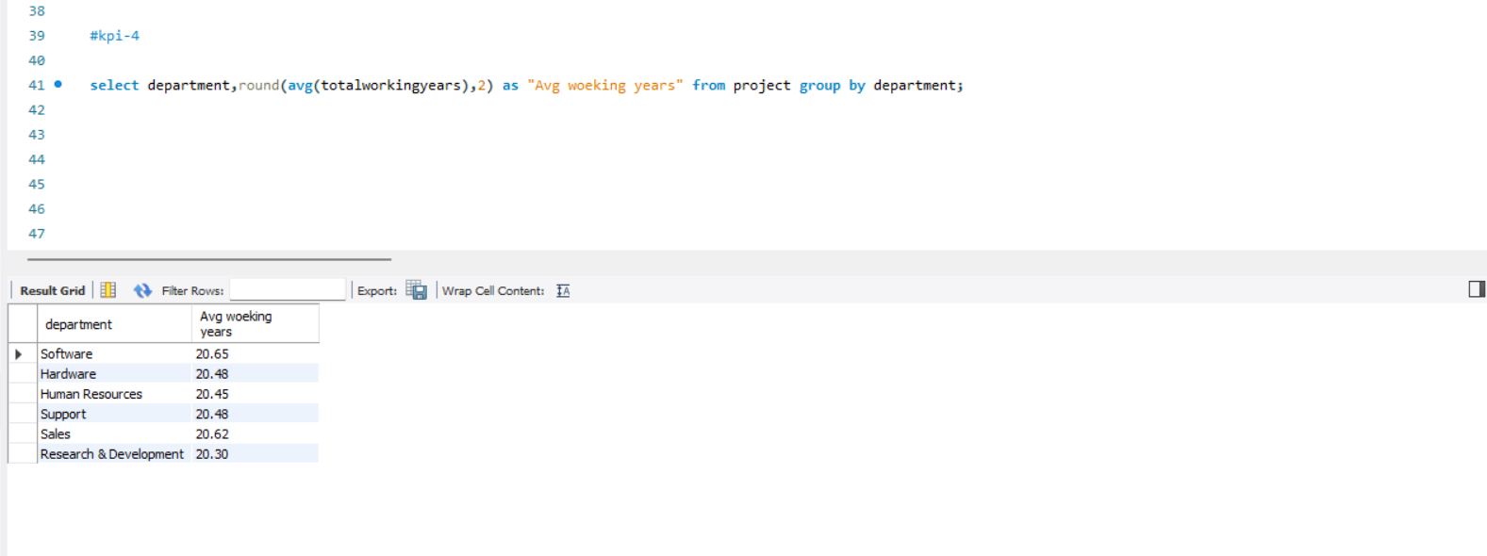
Using Mysql

Slide 26
Key performance indicator-4

Slide 27
5.Job Role Vs Work life balance

Slide 28
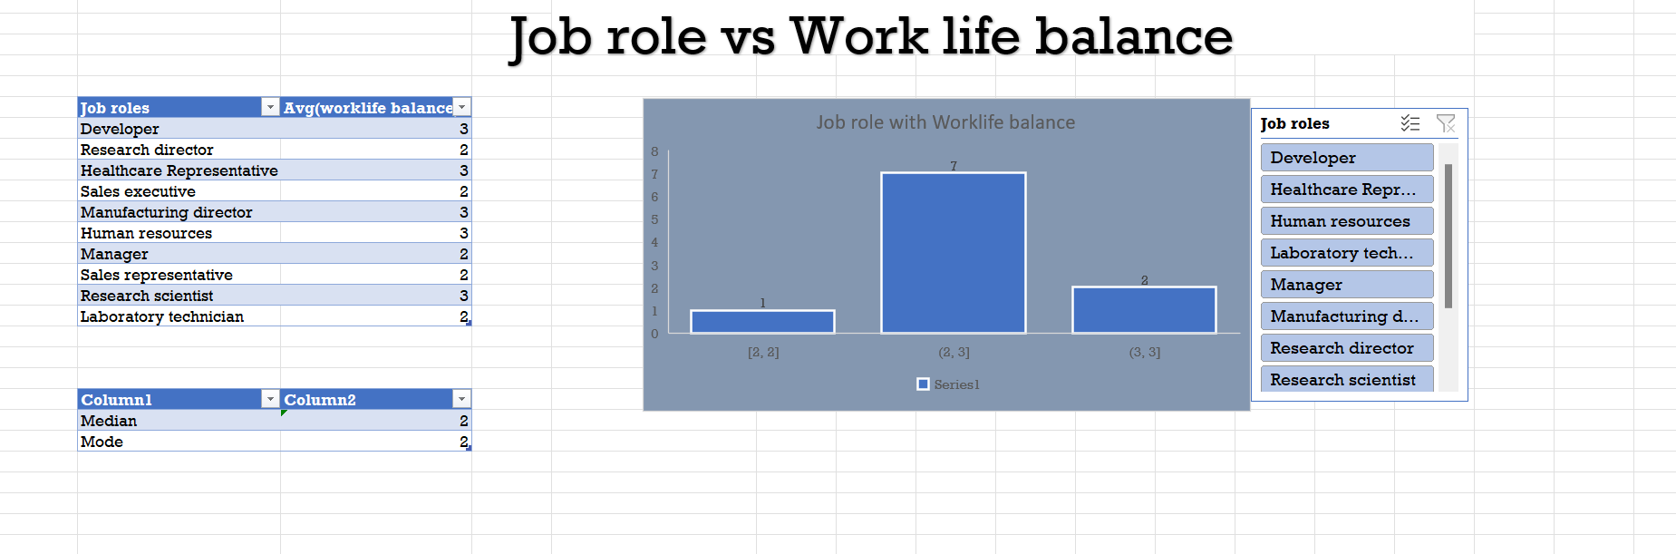
Using excel

Slide 29
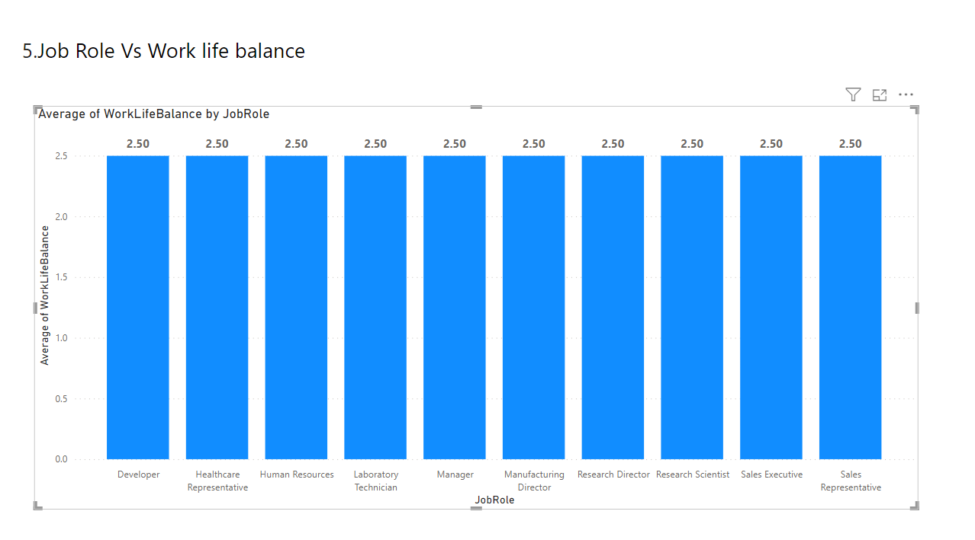
Using power bi

Slide 30
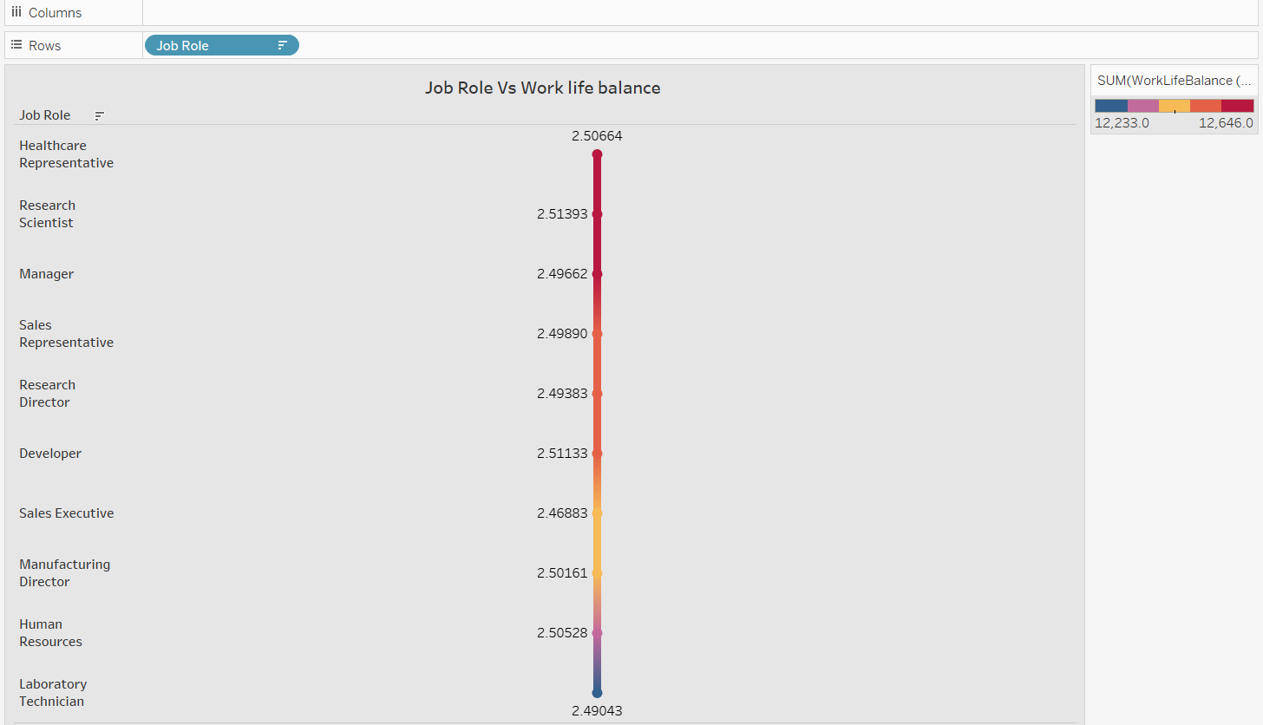
Using tableau

Slide 31
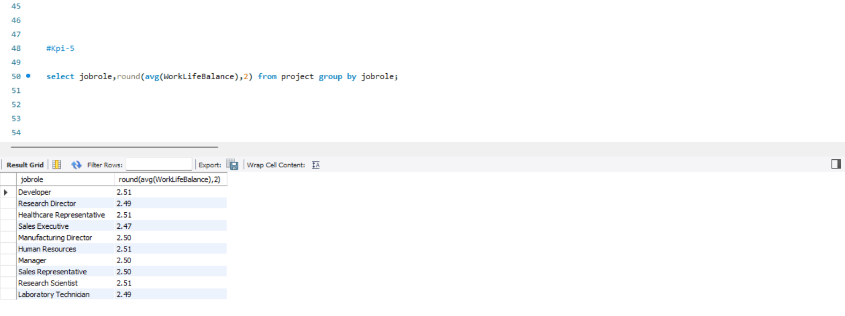
Using Mysql

Slide 32
Key performance indicator-5

Slide 33
6.Attrition rate Vs Year since last promotion relation

Slide 34
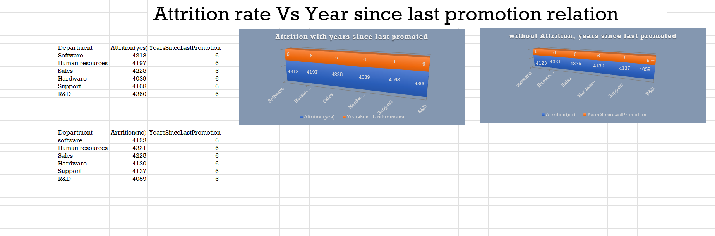
Using excel

Slide 35
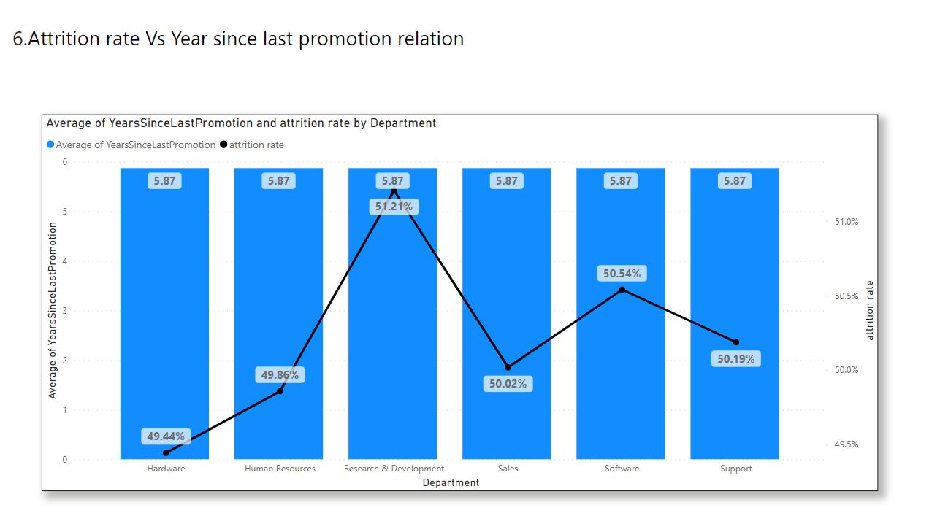
Using power bi

Slide 36
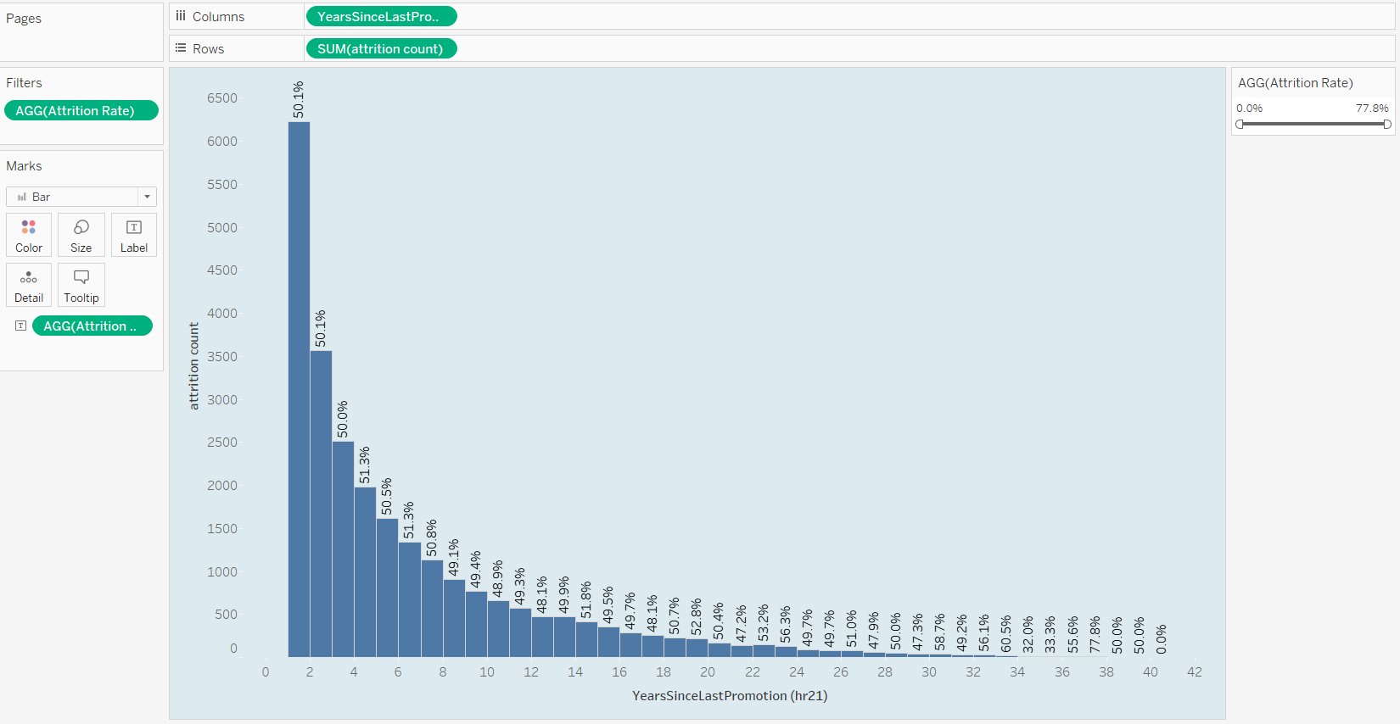
Using tableau

Slide 37
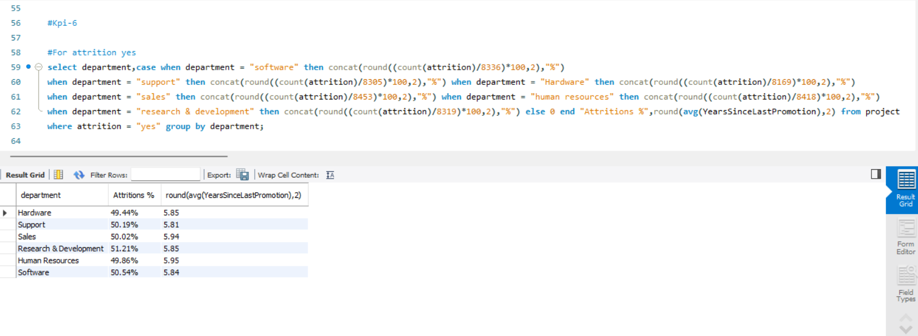
Using Mysql

Slide 38
Key performance indicator-6

Slide 39
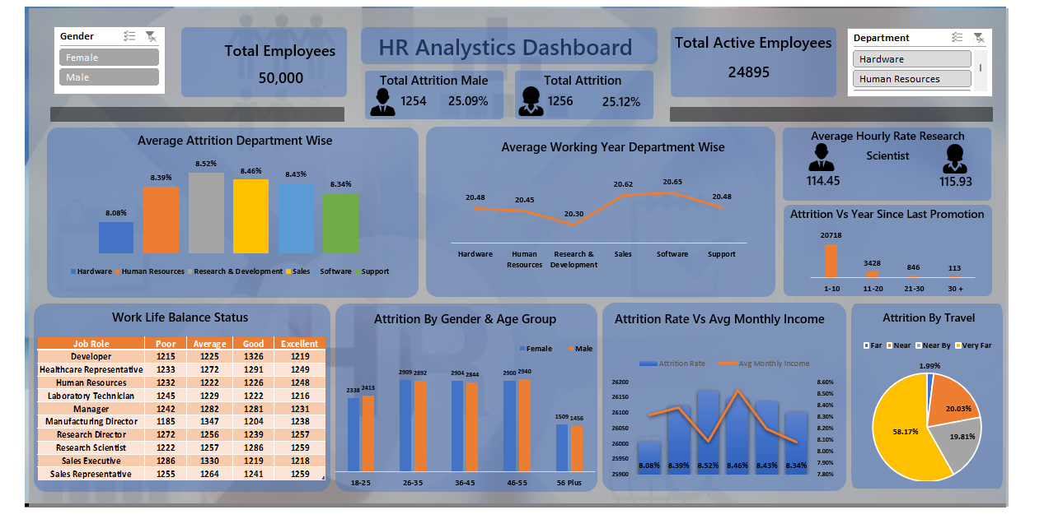
Excel dashboard

Slide 40
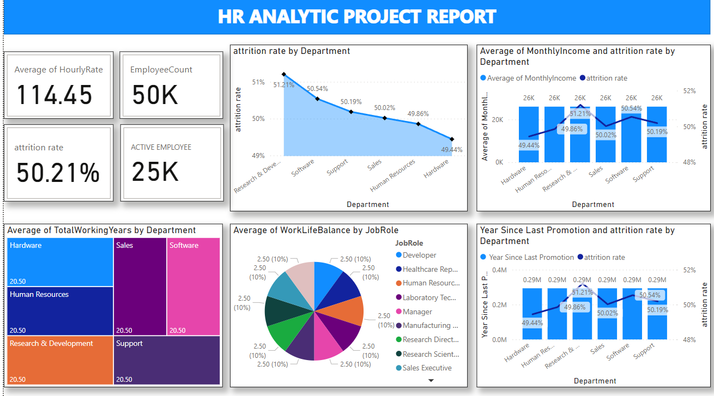
Power bi dashboard

Slide 41
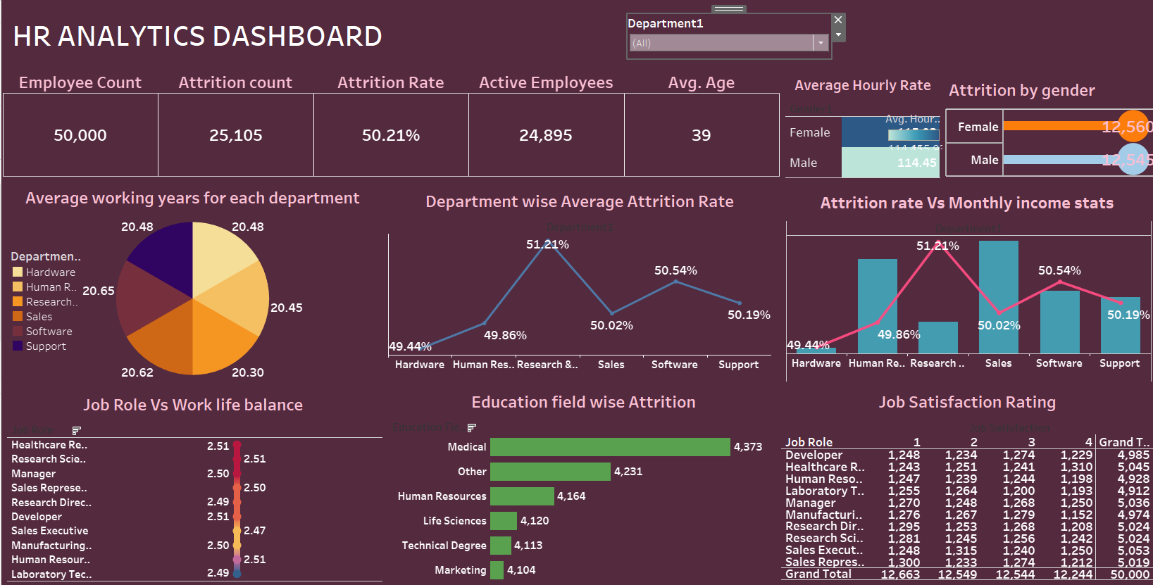
Tableau dashboard

Slide 42
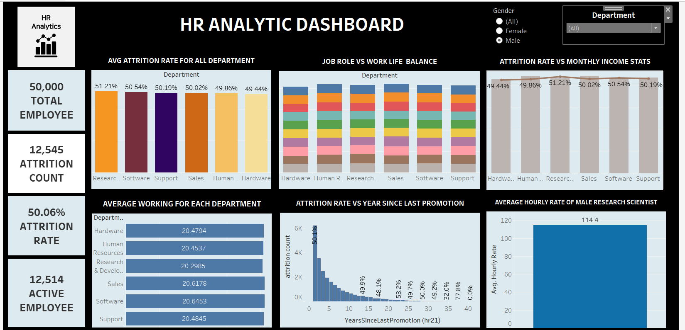
Tableau dashboard

Slide 43
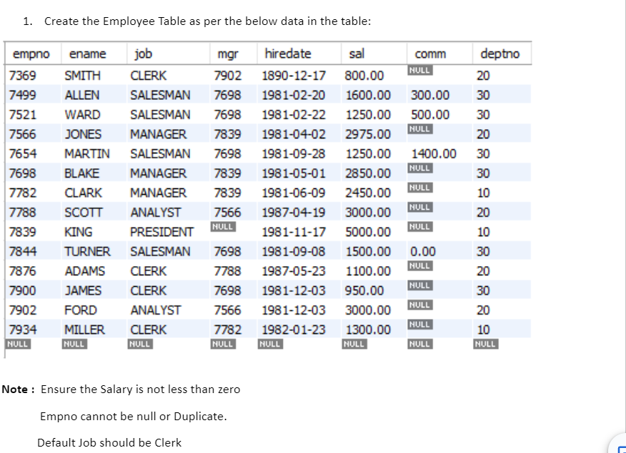
Mysql Questions

Slide 44
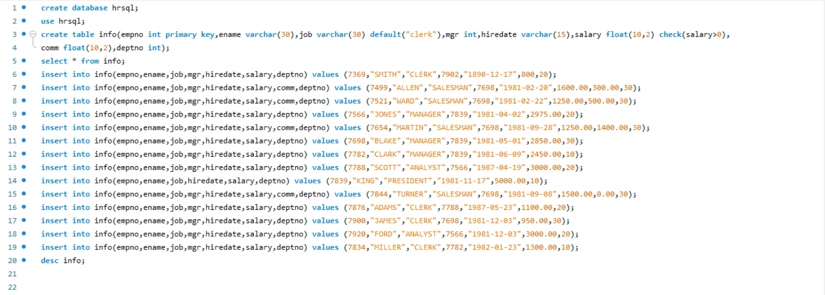
Queries for creating the table under the given conditions

Slide 45
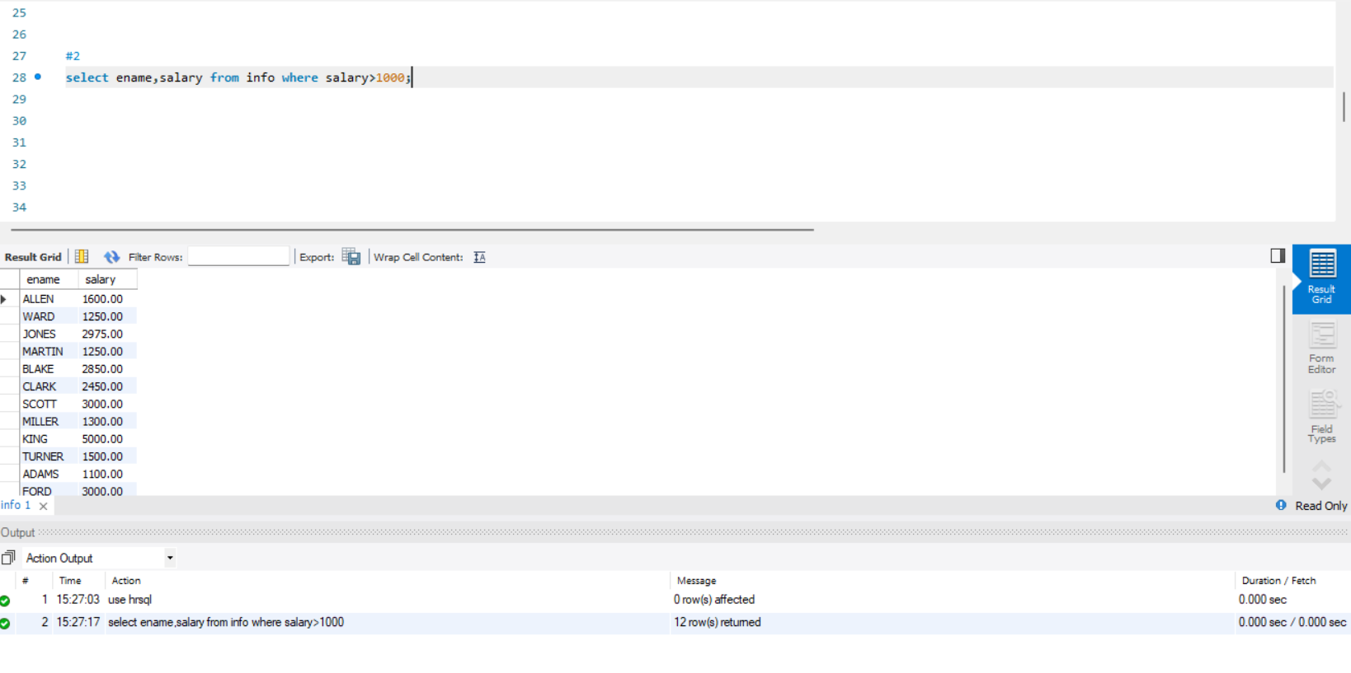
2.List the Names and salary of the employees whose salary is greater than 1000

Slide 46
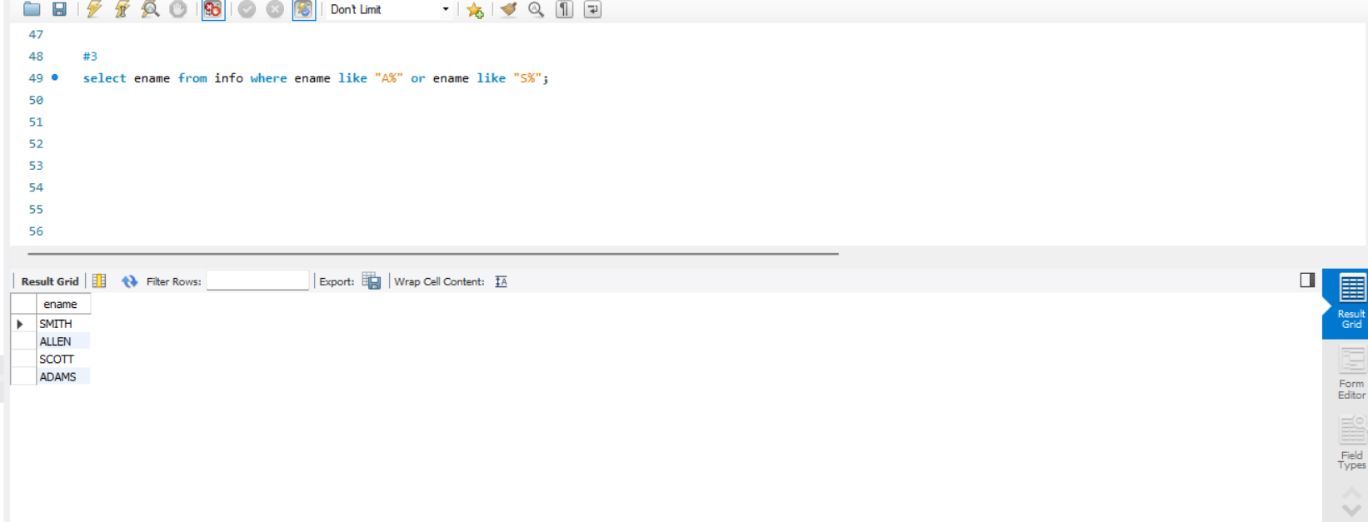
3.List Employee Names whose names start with either A or S.

Slide 47
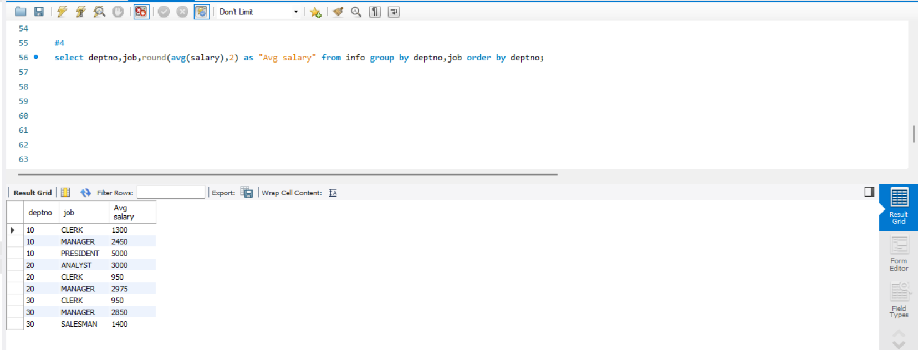
4. List average monthly salary for each job within each department

Slide 48
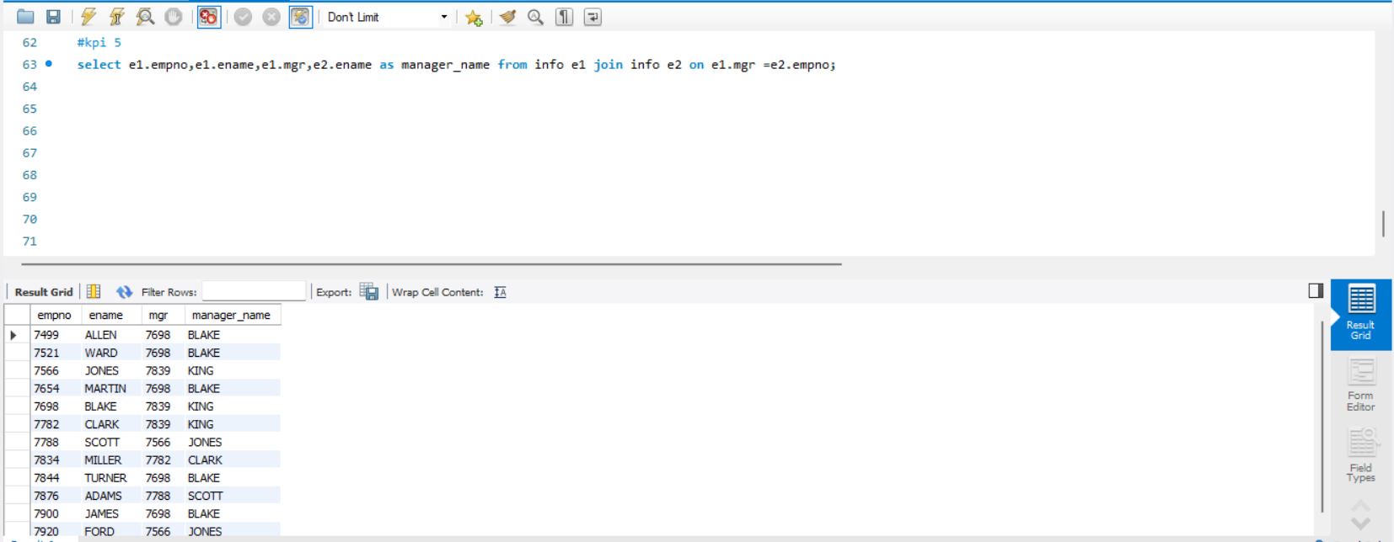
5. Display the empno, Emp name and the Manager name under whom the Employee works.

Slide 49
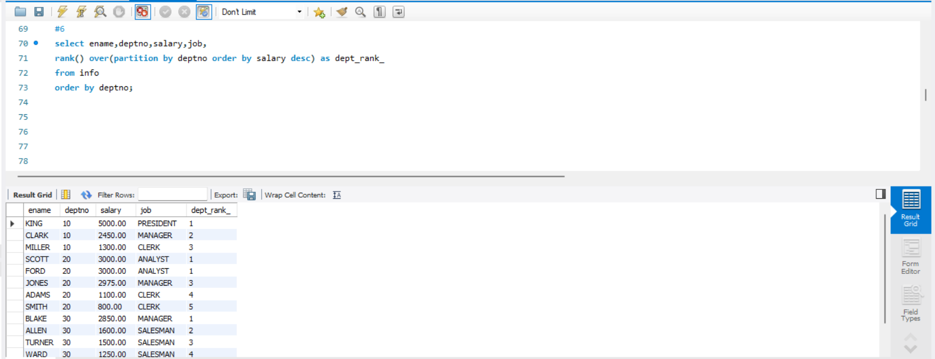
6. Display Empname, department no, salary , Rank of salary in Organization , Rank of Salary in their respective department

Slide 50
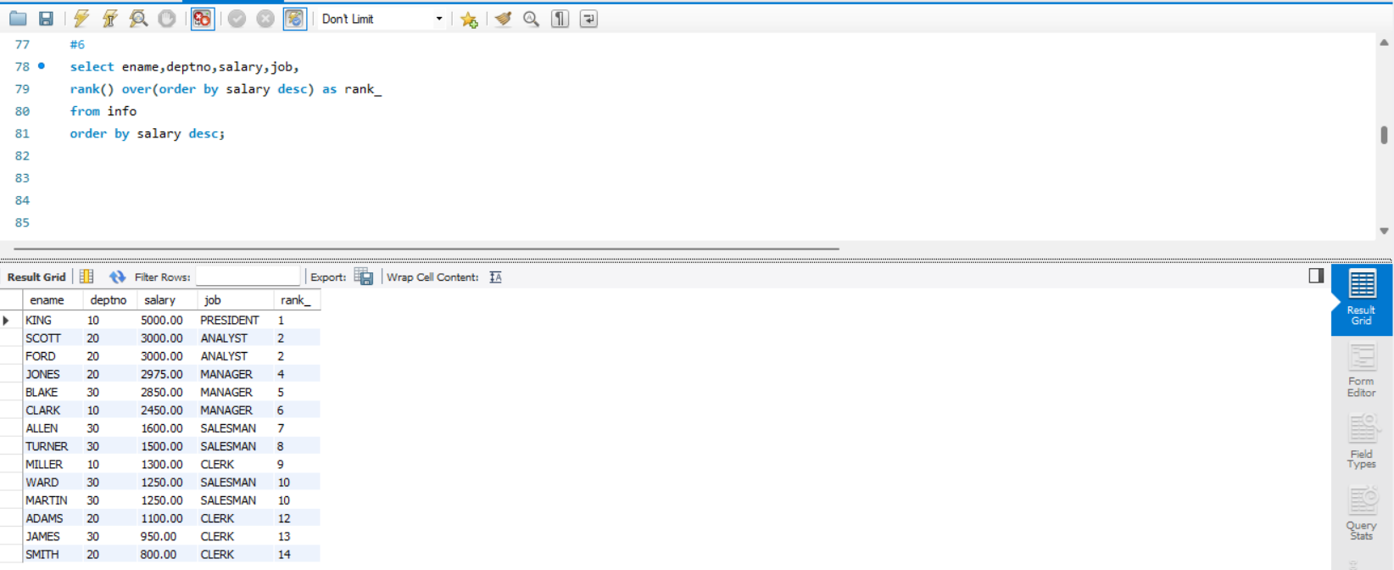
Rank by salary Order

Slide 51

names
Presented by
group-4

